Slide 1


  HOME
  SERVICE
  ABOUT US
  CONTACT US
TECHNO-METER
TURNING WASTE INTO WISDOM FOR PHYSICS LABS
Group number : 30207 New Cairo STEM School

Slide 2
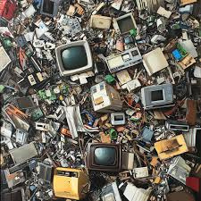
INTRODUCTION
Problem Statement :
  Inefficient E-waste recycling in Egypt
  Heavy metal pollution in air and Nile water
  Lack of affordable motion-measurement tools in school labs
  Discarded devices labeled as “waste” despite high value
Research Background :
  PCB recycling: effective but complex and costly
  Ultrasonic sensors: accurate distance measurement
  Previous solutions lack educational accessibility

Slide 3
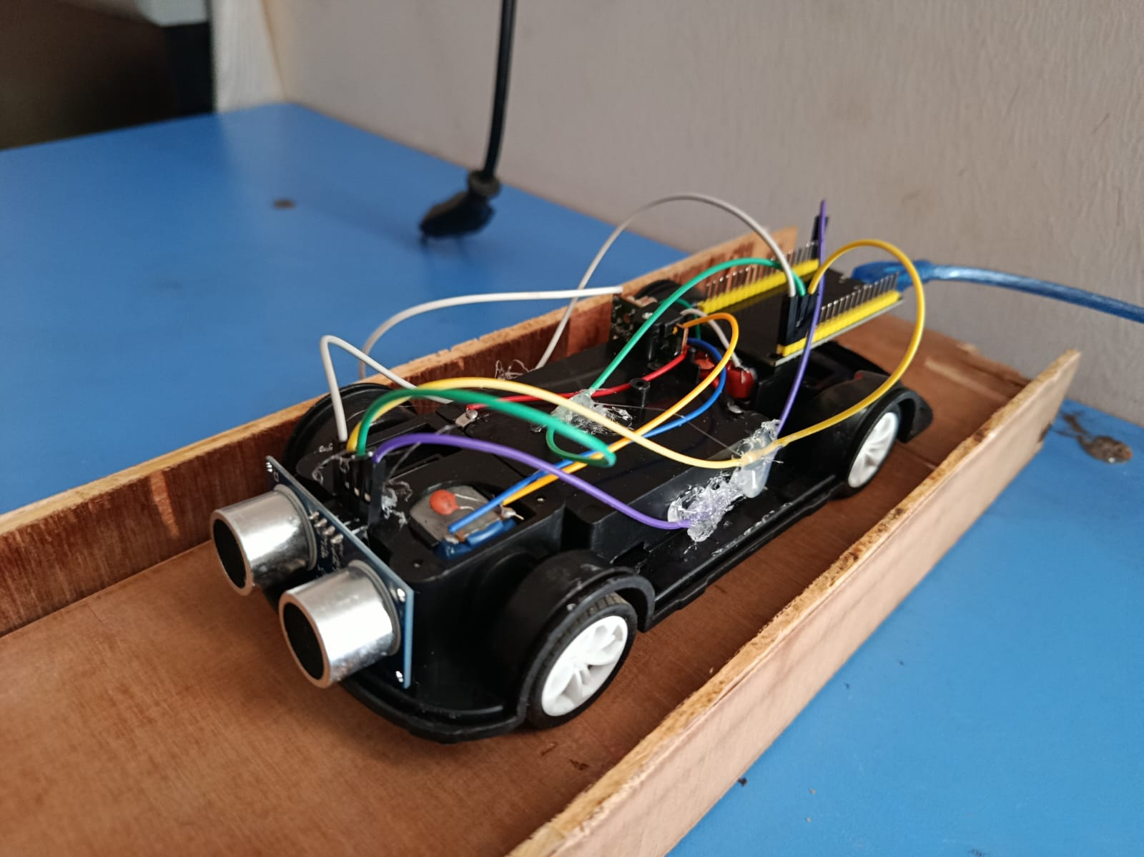
DESIGN REQUIREMENTS & CONSTRAINTS
  Built mainly from discarded devices
  Multi-functional or multi-lab usage
  No hazardous or radioactive materials
  Safe for students
  Error percentage ≤ ±5%
  Improve scientific & technological environment

Slide 4

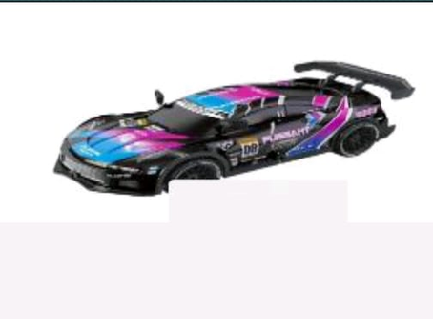
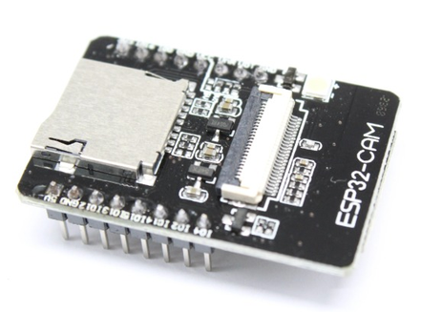
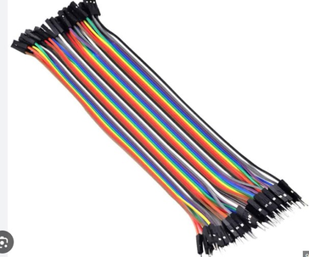
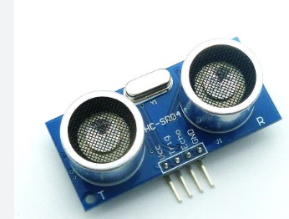

OUR
MATERIALS
01
03
OLD TOY CAR
ESP-32 CAM
05
JUMPER WIRES
02
04
ULTRA-SONIC SENSOR
DISCARDED WOOD

Slide 5
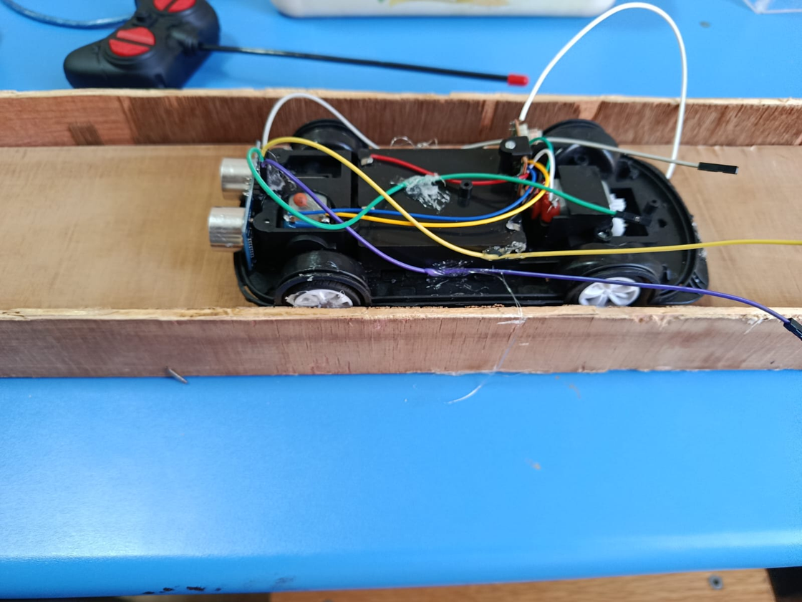
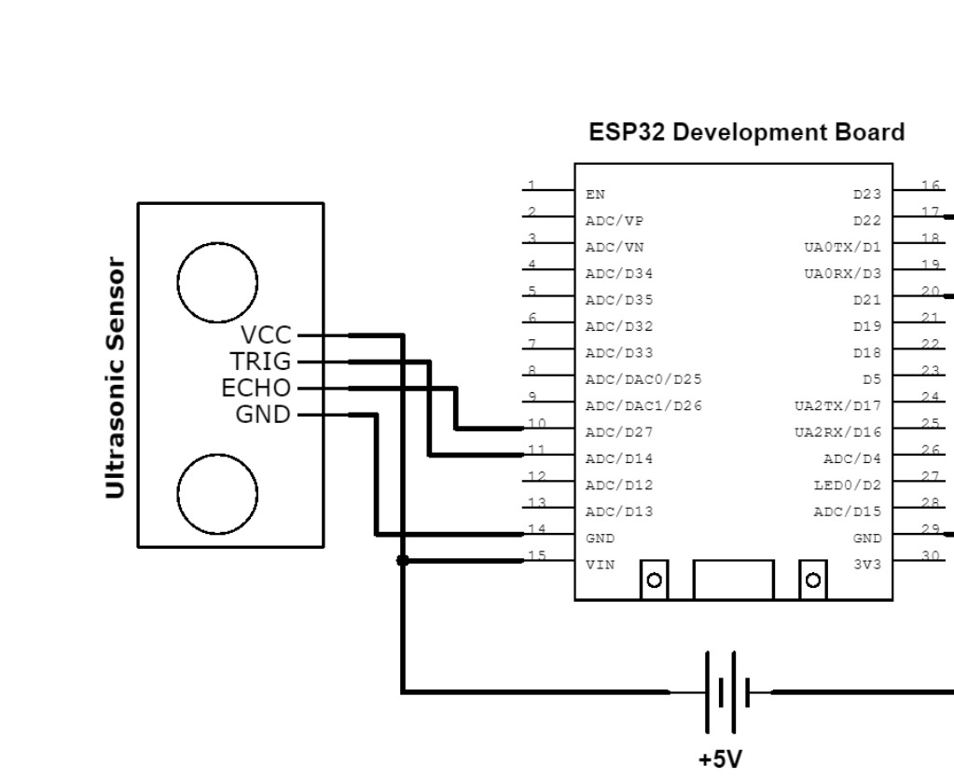
METHODOLOGY (CONSTRUCTION STEPS)
  EXTRACT MICROCONTROLLER FROM DISCARDED CAMERA
  CALIBRATE ULTRASONIC SENSOR
  CONNECT COMPONENTS USING OLD WIRES
  PROGRAM ESP32-CAM
  DEVELOP IOT WEBSITE (HTML, CSS, JAVA)
  ASSEMBLE SYSTEM ON TOY CAR

Slide 6
TEST PLAN & SAFETY
  Safety precautions:
- Gloves
- Lab coats
  Calibration under lab conditions
  Manual vs sensor measurements
  Controlled environment
  Taking the results from the website to be analyzed

Slide 7

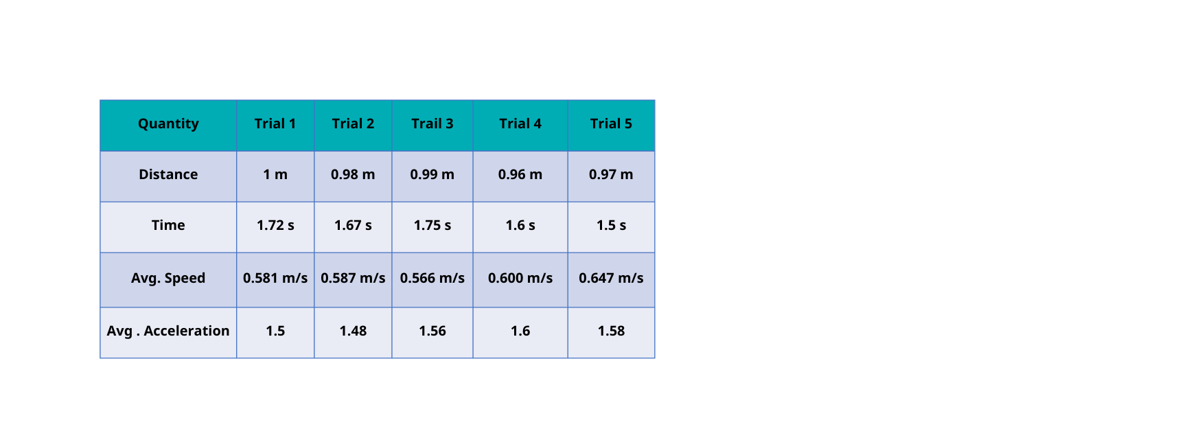
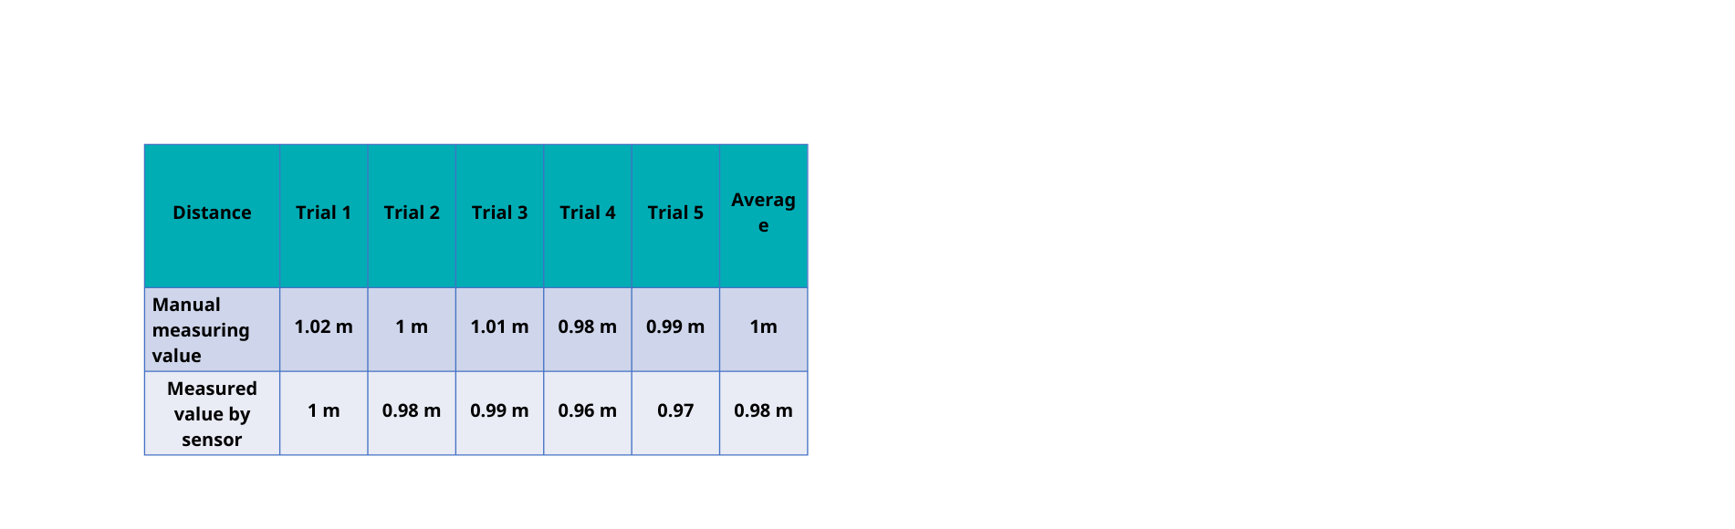
TABLE 2: TEST PLAN READINGS
OUR RESULTS
NEGATIVE RESULTS
  Initial experiments used a Hall effect sensor to measure distance
  The sensor showed inconsistent readings and skipped pulses
  Average measured distance was ≈ 0.70 m instead of 1.00 m
  Error percentage reached ~30%, exceeding acceptable limits
  Causes of error:
  Incompatibility with ESP32-CAM
  Magnet size affected pulse detection
  Mechanical instability of the rotating wheel
Table 1: Distance readings
OPTIMIZED RESULTS & SYSTEM PERFORMANCE
Table 2 :Test Plan Readings
  Hall effect sensor replaced with an ultrasonic sensor
  Distance measured using Time-of-Flight (TOF) principle
  Manual distance average: 1.00 ± 0.02 m
  Sensor distance average: 0.98 ± 0.02 m
  Final error percentage reduced to ≈ ±2%
  Speed and acceleration calculated accurately
  Stable graphs suitable for physics lab experiments

Slide 8
ANALYSIS
  Initial measurements using the Hall effect sensor showed large deviations
  The measured distance (≈ 0.70 m) differed significantly from the actual distance (1.00 m)
  Error percentage reached ~30%, which is unacceptable for physics lab applications
  Scientific interpretation:
  Hall effect sensors depend on accurate magnetic pulse detection
  Pulse skipping occurred due to:
  Magnet size mismatch
  Mechanical instability
  Sensor–microcontroller incompatibility
  The Hall effect sensor was replaced by an ultrasonic sensor

Slide 9
SYSTEM ARCHITECTURE
  Ultrasonic sensor measures distance (TOF method)
  ESP32-CAM processes data
  Website displays:
Tables
Graphs
  IoT-based real-time monitoring
WORKING PRINCIPLE
  Ultrasonic wave emitted → reflected → received
  Time of flight used to calculate distance
  Speed and acceleration derived mathematically
  Environmental factors considered (temperature

Slide 10
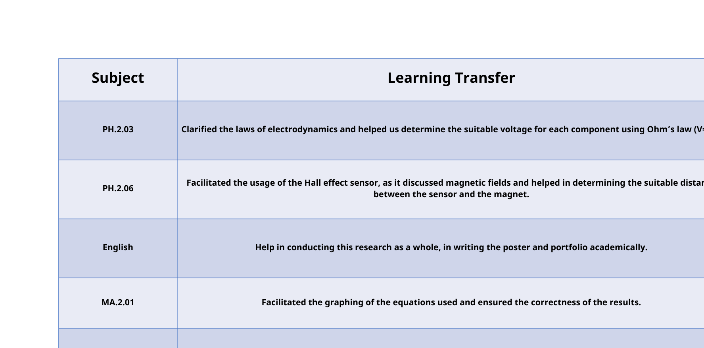
LEARNING TRANSFER

Slide 11

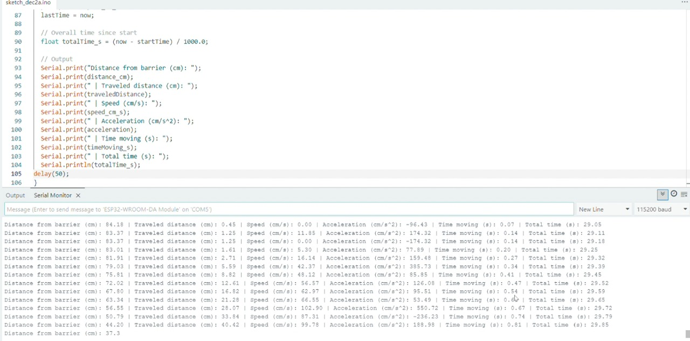

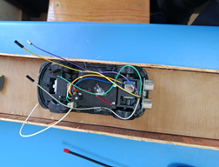
CONCLUSION
This project demonstrates that recycled electronic waste can be transformed into a reliable and educational scientific tool. Through iterative testing and analysis, initial limitations—such as the failure of the Hall effect sensor—were identified, scientifically interpreted, and successfully addressed by adopting ultrasonic sensing technology. This optimization reduced the measurement error from approximately 30% to ±2%, meeting and exceeding the project’s design requirements.
The final prototype accurately measures distance, speed, and acceleration, and provides real-time data visualization through an IoT-based website, making it highly suitable for physics laboratory applications. Beyond technical performance, the project highlights the potential of sustainable engineering to enhance the scientific and technological environment while simultaneously reducing electronic waste.
  Overall, the Techno-meter confirms that low-cost, recycled components, when combined with sound scientific principles and systematic analysis, can deliver accurate, reliable, and environmentally responsible solutions for educational use.

Slide 12
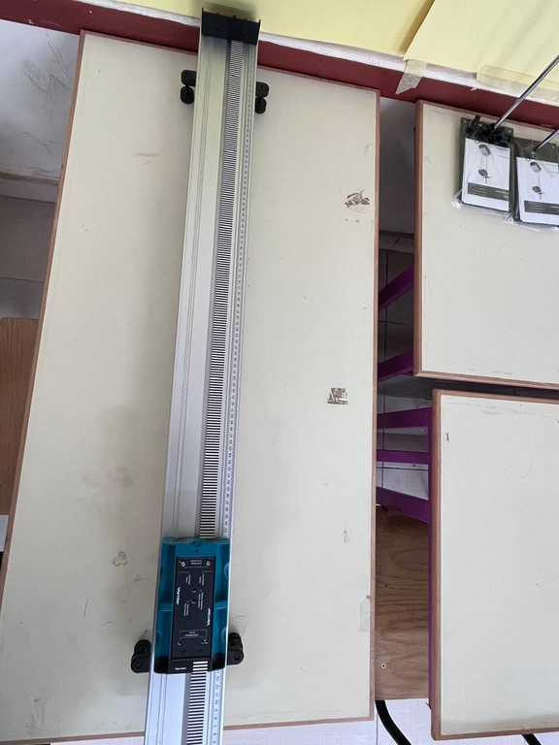
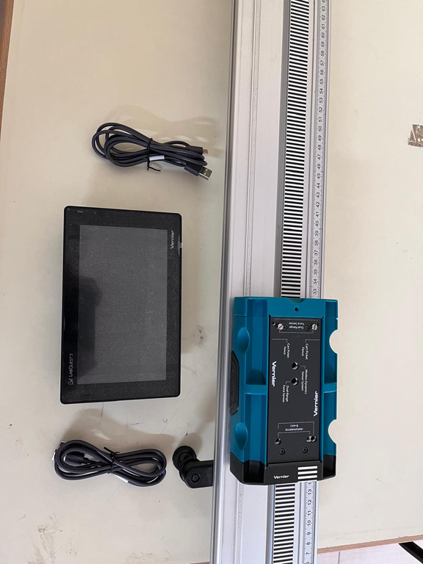
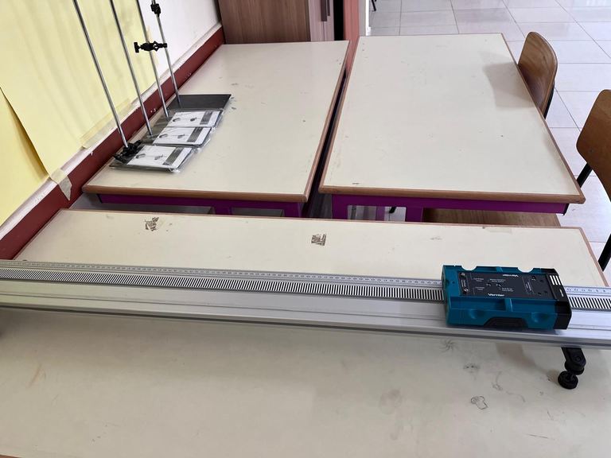
RECOMMEDATION
There is no perfect prototype, and our prototype is not exception. We recommend some features and attributes that can make major effects in the project that could help in improving the application and efficiency of our project. To turn this project to a final product several suggestions should be considered as follows:
I. Improve Measurement Accuracy: using better, more accurate sensors along with the processing unit is critical for a larger scale building, considering its scarcity regarding small scale prototypes.
II. Reinforce Mechanical Components: Strengthen the car chassis and overall car body and the track, ensure stable performance and reduce errors considering high-speed testing
III. Adopt adaptive design: use flexible sensor and hardware modules for replacements and customizations for educational lab experiments.
IV. Increase Sustainability Impact: adopt a well-studied technique of recycling waste materials (using a well-studied plan of which materials will be recycled and how to ensure having the best impact on earth)
  V. Ensure Reliability and Safety: to make a final product out of our prototype, it must meet several safety requirements and standards to withstand any crisis and save students from any fatal error.

Slide 13
LITERATURE CITED
1.ABDEL-SATAR, A. M., ALI, M. H., & GOHER, M. E. (2017). INDICES OF WATER QUALITY AND METAL POLLUTION OF NILE RIVER, EGYPT. EGYPTIAN JOURNAL OF AQUATIC RESEARCH, 43(1), 21-29.
2.Aliew, F. (2022). An approach for precise distance measuring using ultrasonic sensors. Engineering Proceedings, 24(1), 8.
3.Cameron, N. (2023). ESP32 microcontroller. In ESP32 Formats and Communication: Application of Communication Protocols with ESP32 Microcontroller (pp. 1-54). Berkeley, CA: Apress.
4.Ghanem, S., Ferrini, S., & Di Maria, C. (2023). Air pollution and willingness to pay for health risk reductions in Egypt: A contingent valuation survey of Greater Cairo and Alexandria households. World Development, 172, 106373.
5.Jeon, S., & Seo, D. (2019). Smart parking system based on an ultrasonic sensor and bluetooth low energy in the internet of things. J. Syst. Manag. Sci, 9, 91-110.
6.Salikhov, R. B., Abdrakhmanov, V. K., & Safargalin, I. N. (2021, November). Internet of things (IoT) security alarms on ESP32-CAM. In Journal of Physics: Conference Series (Vol. 2096, No. 1, p. 012109). IOP Publishing.
7.Tan, Q., Liu, L., Yu, M., & Li, J. (2020). An innovative method of recycling metals in printed circuit board (PCB) using solutions from PCB production. Journal of Hazardous Materials, 390, 121892.

Slide 14



THANK
  HOME
  SERVICE
  ABOUT US
  CONTACT US
YOU
http://feronabil2008-del.github.io/website-techno-meter/.COM

